Slide 1

Integrating the Online BiblioBouts Game to Teach Information Literacy in Academic Classes
Chris Leeder, Victor Rosenberg, Chuck Severance
School of Information
University of Michigan
Notes:
If you want to add BiblioBouts to your classes, please contact us at info@bibliobouts.org. Thank you.

Slide 2
Topics
1. The BiblioBouts Game
2. BiblioBouts Concepts and Issues
3. Integration into LMSs

Slide 3
BiblioBouts Learning Objectives
Using professional tools to find sources on a topic
Library database portal
Library databases
Zotero for source management
Evaluating sources using an established set of credibility and relevance criteria
Formulating a research paper topic
Choosing the best sources for a bibliography on their topic

Slide 4
Game Structure
Students compete against each other to earn points and badges and advance through levels
Students learn from their peers while practicing skills
The game consists of three mini-games or bouts
Each bout gives students practice with a specific subset of information literacy skills within the overall research process
Game play results in a bibliography of high-quality sources for student papers or projects

Slide 5
Pre-Game Class Activity
Search the web and library databases, sources in Zotero

Slide 6
Closer Bout
Choose the best sources from your search results

Slide 7
Tagging & Rating Bout
Evaluate opponents’ sources for credibility and relevance

Slide 8
Best Bibliography Bout
From all sources, choose the best for your paper topic

Slide 9
Post-Game Library
Access everyone’s sources to write your paper

Slide 10
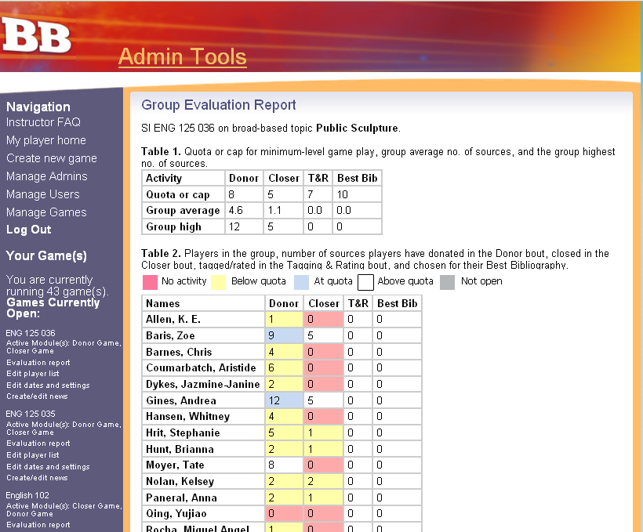
Instructor Evaluation
View students’ progress

Slide 11
Benefits
Realize that library-portal databases yield sources that are qualitatively better than Google, Wikipedia, and the web
Practice using a step-by-step approach to library research and learn a methodology for evaluating sources
Exposure to more diverse sources than working alone
Put more effort into reading, scrutinizing, and comparing sources
Reduce procrastination

Slide 12
Objectives of BiblioBouts
Getting students to use more and better sources.
Teaching research methodology
Do more sources mean better research?
Background of the project
Origins in bibliographic instruction
Bibliographic Instruction is labor intensive and inefficient.
Using older students to mentor younger ones.
The game is used to make bibliographic instruction scalable.

Slide 13
Objectives of the Project
Getting students to use sources beyond Google and Wikipedia
Most undergraduates are unaware of library resources
Optimal use of library resources requires information literate students
Teaching students to use reference management software (Zotero)
Teaching students to critically evaluate sources in terms of relevance and credibility.

Slide 14
Motivations for students
Competition, Local and Beyond
Prizes: Cash or Badges
Financial incentives
Course Credit
Course requirement

Slide 15
Major Research Findings
Students learned new skills
Student confidence increased.
Students used new resources
They felt more confident about research skills.
They may have produced better papers.
(We have some anecdotal evidence.)
They may have used better resources
Learned to consider credibility and relevance
Learned to use Zotero: creating bibliographies and formatting citations.

Slide 16
Integrating BiblioBouts using IMS LTI
We are developing an IMS Learning Tools Interoperability integration to plug BiblioBouts into Learning Tools Interoperability
Auto-creation of Instructor and Student Accounts
Auto-creation of the games
Auto-invite of students into games
One-click launch, no separate account or password

Slide 17









L
T
I
LEARNING TOOL
...
PHP
Java
C#

Slide 18
IMS Learning Tools Interop.
LMS Data signed and posted to BiblioBouts
OAuth security
lti_version=LTI-1p0
lti_message_type=basic-lti-launch-request
oauth_consumer_key=lmsng.school.edu
resource_link_id=120988f929-274612
user_id=292832126
roles=Instructor
lis_person_name_full=Charles R. Severance
lis_person_contact_email_primary = csev@umich.edu
context_id=456434513
context_title=SI301 – PHP
tool_consumer_instance_description=University of School

Slide 19
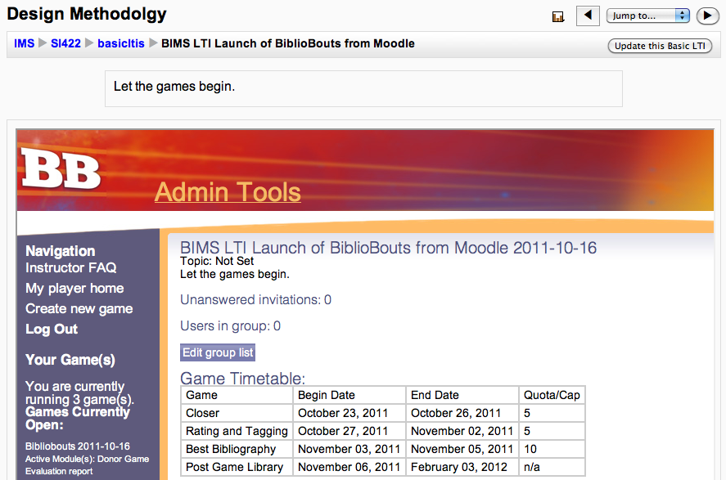

Slide 20
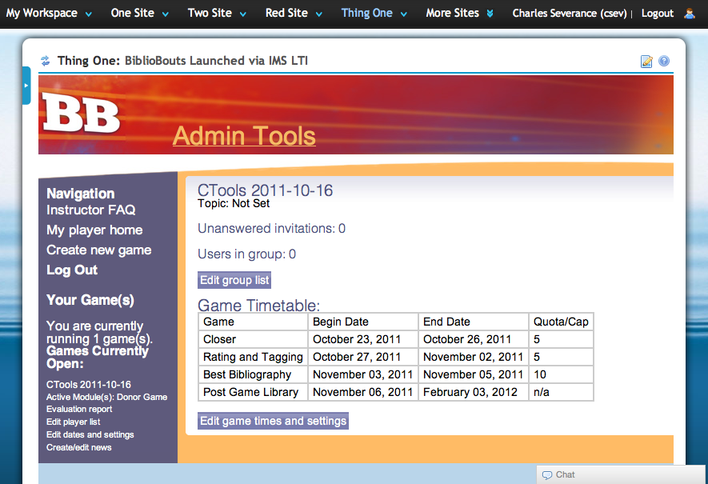

Slide 21
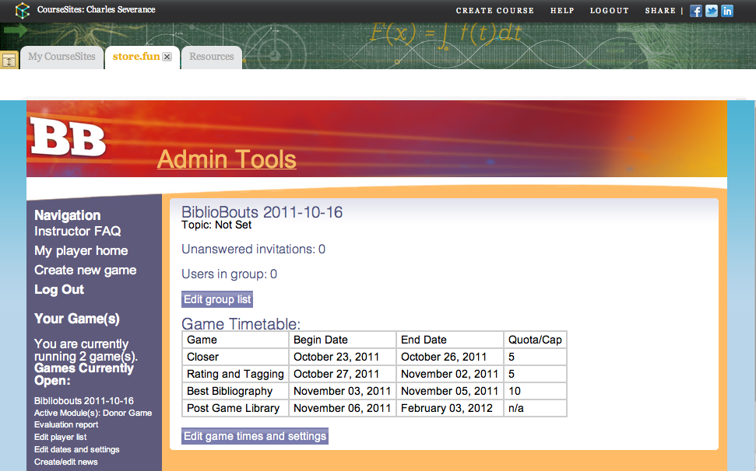

Slide 22
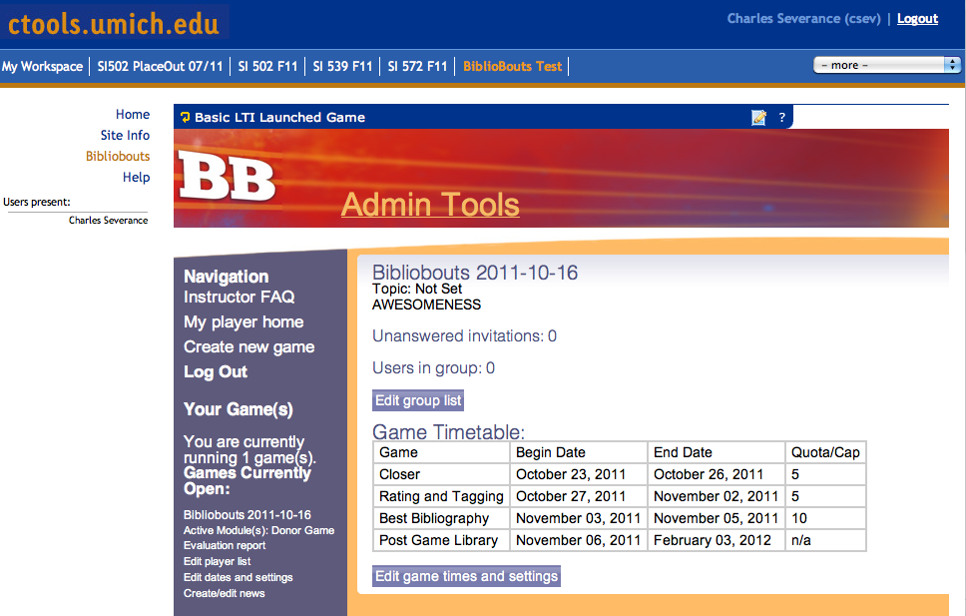

Slide 23
For more information:
Try the game demo: http://bibliobouts.org
[Email: demo@bibliobouts.org, Password: demo]
Read the Instructor FAQ: http://bibliobouts.si.umich.edu/instructorFAQ.html
IMS LTI: http://www.imsglobal.org/developers/BLTI/
Email us at info@bibliobouts.org
Notes:
If you want to add BiblioBouts to your classes, please contact us at info@bibliobouts.org. Thank you.

